Slide 1
British Airways Customer Sentiment Analysis
Leveraging Data to Enhance Customer Satisfaction and Operational Efficiency
Presented by: Dennis Maxwell
Date: 28/01/2025

Slide 2
Introduction
Key Points:
British Airways operates thousands of flights daily across the globe.
Understanding customer sentiment is critical to maintaining loyalty and improving services.
This project analyzes customer reviews to uncover actionable insights.

Slide 3
Objectives
Main Goals:
Identify overall sentiment distribution among reviews.
Analyze common themes in negative feedback to address key pain points.
Provide actionable recommendations to improve service delivery.

Slide 4
Methodology
Steps:
Data Collection: Scraped customer reviews from a third-party source.
Data Cleaning: Removed noise, duplicates, and normalized text.
Sentiment Analysis: Categorized reviews as Positive, Negative, or Neutral.
Text Mining: Extracted keywords and recurring themes.
Visualization: Created charts and word clouds for better insights.

Slide 5
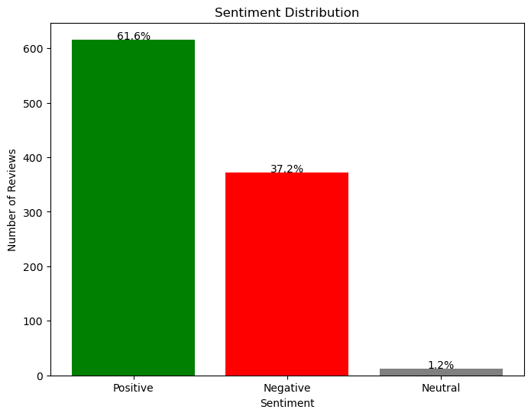
Sentiment Distribution
Key Insights:
61.6% Positive: Indicates overall customer satisfaction.
37.2% Negative: Highlights significant areas of concern.
1.2% Neutral: Reflects balanced feedback.

Slide 6
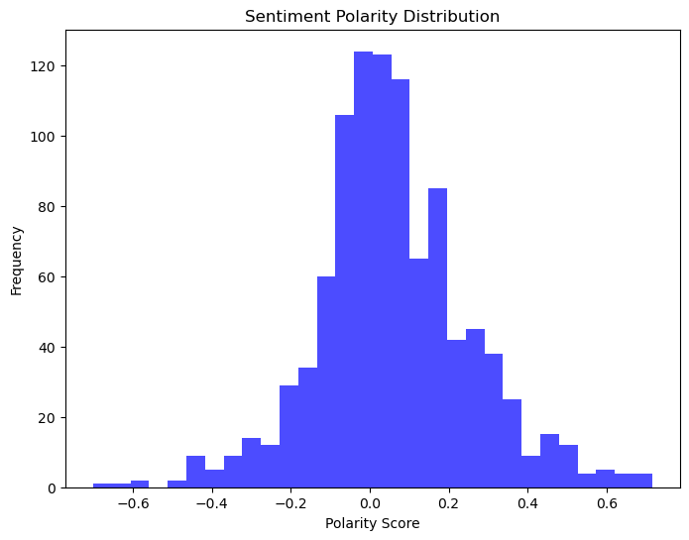
Sentiment Polarity
Key Insights:
Polarity scores highlight a skew towards positive reviews.
A significant negative cluster reflects dissatisfaction in some areas.

Slide 7
Recurring Issues in Negative Reviews
Key Themes:
Flight Delays:
Words: "flight," "time," "hours."
Customers frustrated with delays and waiting times.
Seating Comfort:
Words: "seats," "business class."
Complaints about discomfort in economy and business classes.

Slide 8
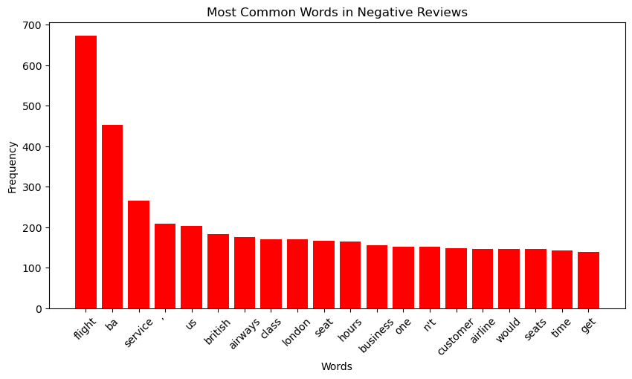
Recurring Issues in Negative Reviews - Cont'd
Customer Service:
Words: "customer," "service," "rude."
Issues with unhelpful or inattentive staff.

Slide 9
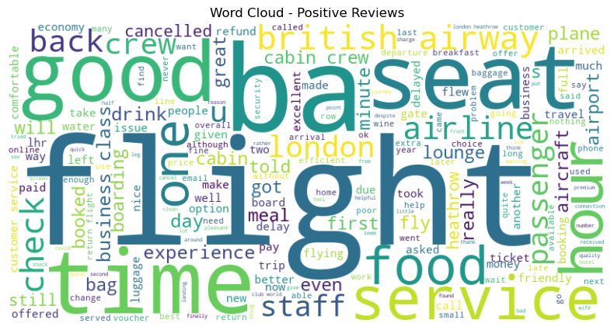
Positive Sentiments
Key Highlights:
Customers appreciate "friendly staff," "smooth flights," and "great service."

Slide 10
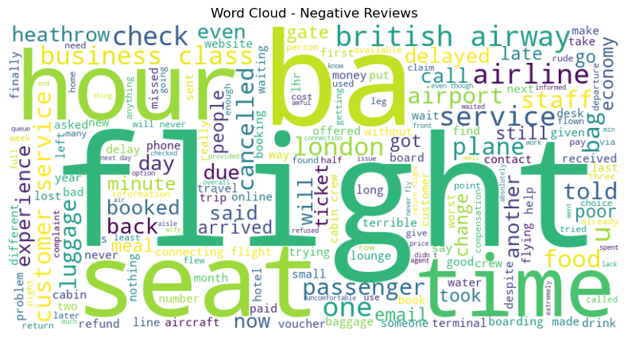
Negative Sentiments
Key Highlights:
Dissatisfaction with delays, seating, and customer service.

Slide 11
Recommendations
Actions to Address Key Issues:
Improve Communication Around Delays:
Real-time updates via mobile apps and SMS.
Offer compensation for extended delays.
Upgrade Seating Comfort:
Revise seat configurations to balance comfort and capacity.
Provide complimentary upgrades for frequent flyers.

Slide 12
Recommendations - Cont'd
Enhance Customer Service Training:
Empathy training and regular skill refreshers for staff.
Reward programs to incentivize excellent service.
Focus on Operational Efficiency:
Optimize turnaround times at hubs like London Heathrow.
Invest in AI-driven systems for resource allocation

Slide 13
Conclusion
Summary:
The analysis highlights areas of strength (positive reviews) and improvement (negative reviews).
Addressing delays, seating, and service can save costs and improve customer loyalty.
By acting on these insights, British Airways can reinforce its reputation as a world-class airline.

Slide 14
Q&A

